Slide 1

A GLOBAL SUPERBUG HUB
The AMR Crisis
Stories, Realities, and Structural Challenges of a Global Superbug Hub
Antimicrobial Resistance Briefing
Notes:
Hello Sir, Today we are discussing antimicrobial resistance (AMR), using India as a central case study to examine both the biological mechanisms of superbugs and the clinical realities faced on the ground.

Slide 2
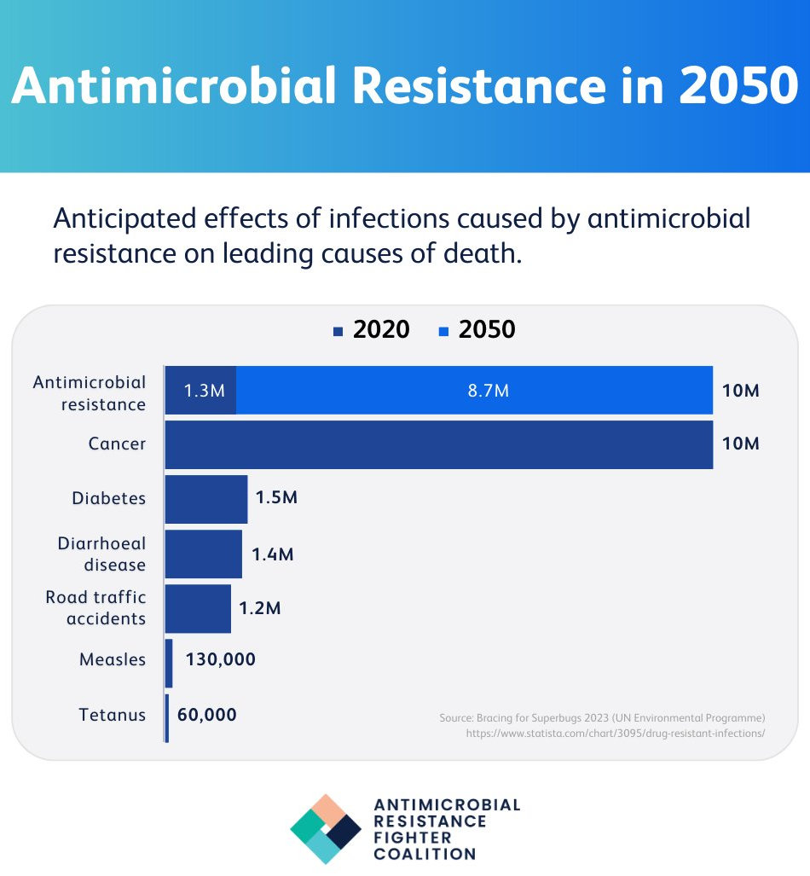
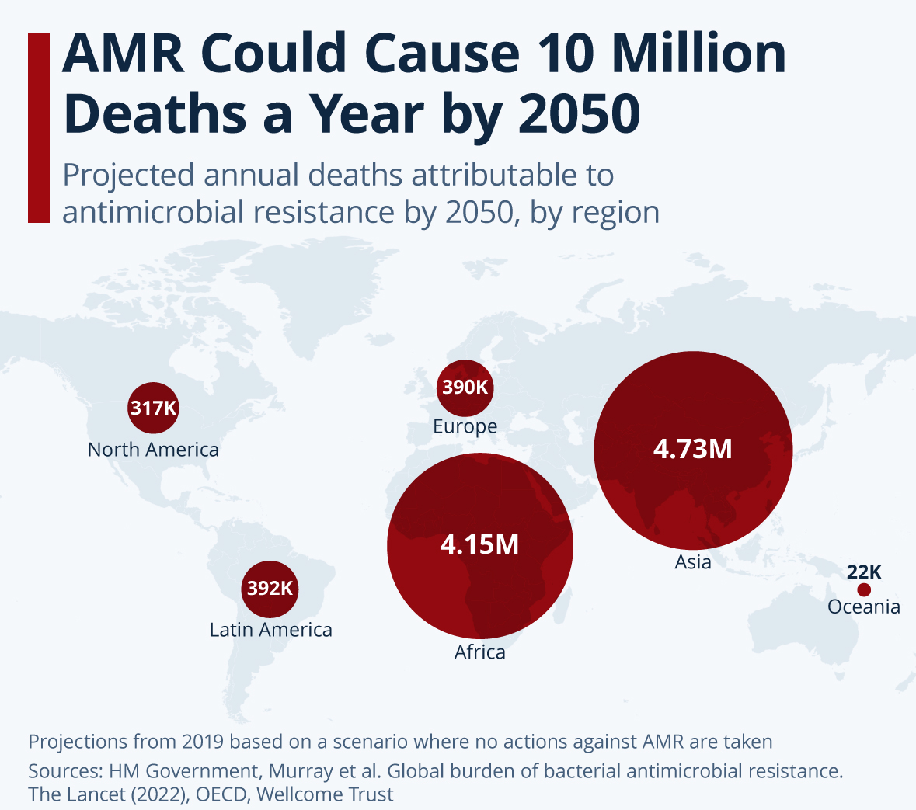


Slide 3








THE AMR MORTALITY DIVIDE
The Global AMR Crisis: Why Mortality Claims Africa and Asia
Structural Vulnerabilities, Not Just Smarter Bugs
THE GRIM FORECAST · Lancet, 2022
THE FOUR DRIVERS OF MORTALITY
27.3 / 100k
1 · High Baseline Disease Burden
Sub-Saharan Africa
Elevated rates of pneumonia, neonatal sepsis, and typhoid mean more raw infection cases directly translate into more resistant deaths.
Highest global AMR mortality rate of any region.
2 · The “Access Paradox”
#2
Excess antibiotic use creates resistance, while lack of drug access kills — wealthy nations pivot to backup drugs; poor regions lack reserve stock.
South Asia
3 · Diagnostic “Blindness”
Closely follows — fueled by dense urban centers.
Rural hospitals lack advanced microbiology labs, forcing doctors to guess treatments without rapid blood cultures.
60%
4 · Sanitation Infrastructure
Children Under 5
Tropical climates and weak sewage systems circulate gut bacteria; multi-resistant strains spread rapidly through water supplies.
Bear nearly 60% of Africa's total AMR death toll.
Key Insight: Preventing AMR deaths in Africa and Asia requires looking beyond the lab. The true solution lies in clean water access (WASH), primary healthcare labs, and equal access to backup antibiotics.

Slide 4

India: A Global AMR Hotspot
2.97 lakh
up to 12 lakh
AMR-attributable deaths in India, 2019 (Lancet)
projected AMR-associated deaths/year by 2030 if trends continue (IHME)
Antimicrobial Resistance — Clinical Briefing

Slide 5





The Pathogen Shift
A shift from manageable Gram-positive bacteria to aggressive Gram-negative pathogens.
Primary Culprits
Klebsiella pneumoniae and Acinetobacter baumannii dominate Indian NICUs.
02 · ON THE FRONTLINE
The Neonatal ICU Battle
First-Line Failure
High rates of immediate resistance to standard ampicillin and gentamicin.
Newborns are on the frontline of India's resistance crisis, where standard treatments increasingly fail.
Last-Resort Reliance
Doctors are forced to use toxic or highly restricted drugs like colistin on newborns.
The AMR Crisis in India
Notes:
This is where the crisis gets scary. In Indian NICUs, newborns are battling aggressive Gram-negative bacteria that are already immune to standard first-line treatments, forcing doctors to rely on toxic last-resort antibiotics.

Slide 6






CONTEXT
Why India Is Especially Vulnerable to AMR
Widespread self-medication
High infectious-disease burden
Antibiotics are frequently obtained and used without a prescription despite Schedule H1.
Dense populations and high infection incidence drive heavy antibiotic demand.
Irrational combinations
Intensive livestock farming
Fixed-dose combinations without scientific justification have circulated widely.
Rapidly growing poultry and aquaculture sectors have relied on antibiotics for growth and disease prevention.
A major generics manufacturing hub
Gaps in sanitation & water
India supplies a large share of the world's generic antibiotics — and its production waste.
Incomplete WASH infrastructure lets resistant organisms spread through water and waste.
Antimicrobial Resistance — Clinical Briefing

Slide 7
ENVIRONMENTAL DRIVER
Industrial Effluent: The Pharmaceutical Manufacturing Belt
India manufactures a large share of the world's generic antibiotics. Bulk-drug manufacturing clusters around Hyderabad (Patancheru, Bollaram) have been studied for over a decade as sites of severe pharmaceutical pollution.
up to 6.5 mg/L
≈ 45 kg/day
86%
ciprofloxacin measured in treated effluent — hundreds to thousands of times above levels known to select for resistance
ciprofloxacin discharged from one common effluent plant — equivalent to the total daily dose for a city of 44,000 people
of bacterial strains isolated from a treatment plant resisted 20 or more antibiotics; one strain resisted 36 of 39 drugs tested
Sources: Larsson et al. 2007/2009 (Univ. of Gothenburg); Changing Markets Foundation, Hyderabad's Pharmaceutical Pollution Crisis
Antimicrobial Resistance — Clinical Briefing

Slide 8
ENVIRONMENTAL DRIVER
From Factory Effluent to Drinking-Water Rivers
Bulk-drug
plants
Common effluent
treatment plant
Iskkavagu
stream
Nakkavagu &
Manjeera rivers
Godavari
basin
▶
▶
▶
▶
~90 units,
Patancheru
Incomplete
removal
Local
discharge
Hyderabad
drinking source
Irrigates millions
of acres
Documented antibiotic concentrations in Patancheru-area sewer networks (µg/L)
OTHER DOCUMENTED HOTSPOTS
Musi river (Hyderabad) — antibiotic residues and resistance genes found upstream, midstream and downstream.
Kazhipally lake — high pharmaceutical pollution and resistant genes documented over a decade of study.
Yamuna river — flagged as an environmental AMR hotspot near urban and industrial discharge points.
Source: Lübbert et al. 2017; Frontiers in Antibiotics, 2024 mapping study
Antimicrobial Resistance — Clinical Briefing

Slide 9



AGRICULTURAL DRIVER
Livestock, Poultry & Aquaculture Contamination
Intensive poultry farming expanded rapidly on the back of antibiotics used not to treat disease, but to promote growth and prevent it prophylactically — often without veterinary prescription.
Projected livestock antibiotic consumption in India (tonnes/year)
Colistin as a growth promoter
A last-resort human antibiotic was marketed and sold to poultry farmers without prescription for years.
The 2019 colistin ban
India prohibited colistin manufacture, sale & distribution in food-producing animals, poultry, aquaculture & feed supplements — a strong, low-ambiguity ban.
Aquaculture residues
A ~7% rise is projected, driven by intensive-farming growth, especially in poultry. Source: Tiseo et al. 2020
Antibiotic use in fish and shrimp farming leaves residues in pond water that reaches surrounding waterways.
“Colistin was highly misused in the poultry industry as a growth promoter — one of the reasons for AMR in India.”
— Drugs Controller General of India, 2019
Antimicrobial Resistance — Clinical Briefing

Slide 10
THE BIOLOGICAL THREAT
NDM-1
The Discovery Isolated in 2008 from a patient who traveled to New Delhi.
A Gene, Not a Species NDM-1 is a gene (bla-NDM-1) carried by many different bacteria.
Bypasses Standard Inhibitors A metallo-beta-lactamase using zinc, not serine — clavulanate and tazobactam cannot bind or disable it.
Broad Carbapenem Destruction Destroys penicillins, advanced cephalosporins, and carbapenems — our last-resort antibiotics.
Plasmid-Borne Spread Rides mobile plasmids, jumping horizontally between entirely different bacterial species.
Global Reach Carried worldwide by human transit and migratory birds — documented as far as the Arctic.
The AMR Crisis in India
2
Notes:
The NDM-1 controversy showed that AMR knows no borders. It is exceptionally dangerous because it operates as a metallo-beta-lactamase. Unlike typical enzymes blocked by standard inhibitors, its zinc-based active site renders drugs like tazobactam useless, while destroying last-line carbapenems. Because it lives on plasmids, it acts like an aggressive software upgrade that bacteria can instantly swap horizontally—which is how it traveled from urban centers to Arctic soil.

Slide 11

MCR-1 - THE ULTIMATE AMR THREAT
The Most Dangerous Gene in Global Health
NDM-1
mcr-1
Eliminates the Final Backup
Strips doctors of colistin, leaving zero validated chemical weapons against some infections.
Highly Transferable
Sits on a plasmid that hitches a ride easily between entirely different bacterial species.
Carbapenem
resistance
Colistin
resistance
PAN-DRUG
RESISTANT
The Pan-Drug Horizon
Frequently merges with NDM-1 inside a single host cell.
A dual NDM-1 + mcr-1 infection creates a completely untreatable pan-drug resistant superbug.
THE AMR CRISIS IN INDIA
Notes:
Why is mcr-1 considered the most dangerous gene today? Because of compatibility. It doesn't just stay isolated; it actively hitches a ride into bacteria that already carry NDM-1. When these two genes combine, we hit the terrifying horizon of total pan-drug resistance.

Slide 12
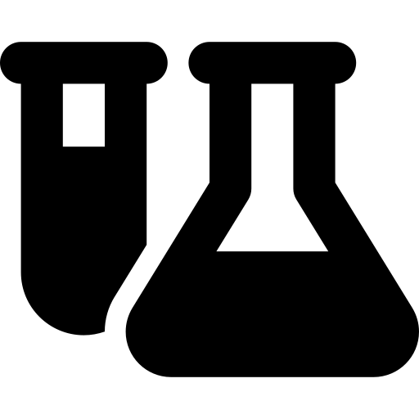



BREACHING THE FINAL LINE
From NDM-1 to mcr-1: Breaching the Final Line
Carbapenem Fallout
Origin of mcr-1
The Breakthrough
Discovered in Shanghai, China (sampled 2011, published Nov. 2015).
First proven case of plasmid-mediated, highly mobile resistance to colistin.
NDM-1 wiped out carbapenems, forcing medicine to resurrect colistin.
The Poisonous Backup
The Source
Traced to E. coli on a commercial pig farm using agricultural growth promoters.
Colistin was shelved for causing severe kidney damage — but became the last option standing.
The AMR Crisis in India
Notes:
This is the critical turning point where the story transitions from bad to worse. When NDM-1 disabled our safest powerful drugs, carbapenems, we had to look backward. Medicine resurrected colistin—an antibiotic that doctors had abandoned for decades because it is highly toxic and dangerous, frequently destroying a patient's kidneys. It was our 'break in case of emergency' glass wall. But in 2015, the discovery of the mcr-1 gene in China proved that bacteria had cracked this final vault, learning to pass colistin resistance easily through plasmids.

Slide 13
Global AMR Policy Trajectory
From resolution to results: the roadmap governments committed to
2024
2024
2026
2030
WHA77.6
WHO resolution sets strategic & operational AMR priorities (2025–35)
UNGA79 Declaration
Political declaration adopted at UN High-Level Meeting, Sept 26
GAP 2.0
Quadripartite (WHO/FAO/UNEP/WOAH) updates Global Action Plan, One Health-aligned
Targets Due
Countries report against binding national commitments
4.95M
10%
60%
70%
annual deaths
associated with bacterial AMR
target reduction in AMR deaths
by 2030
of countries with funded
national action plans by 2030
of antibiotics used should be
WHO Access-group by 2030
Source: UN Political Declaration on AMR, UNGA79 (Sept 2024); WHO/FAO/UNEP/WOAH Quadripartite

Slide 14
Transmission Dynamics: A One Health Web
Resistant organisms move continuously between people, animals, and the environment
Human Health
Clinical use, hospitals,
community infection
Animal & Agriculture
Environment
Livestock, aquaculture,
veterinary antimicrobial use
Water, soil, waste &
sewage effluent
Key drivers accelerating spread across the One Health interface
Overuse & misuse
Non-prescription access, empiric over-treatment, agricultural growth-promotion use
Weak IPC & WASH
Gaps in hand hygiene, sanitation, and hospital infection control
Environmental spread
Pharmaceutical effluent and untreated waste seed resistance genes in ecosystems
Cross-border movement
Travel, trade, and food supply chains carry resistant strains globally

Slide 15
Clinical Action Plan: Bedside to Stewardship
Four coordinated actions clinicians and facilities can implement now
01
Diagnostic Stewardship
Culture before empiric therapy where feasible; use rapid diagnostics to de-escalate within 48–72 hours.
02
AWaRe-Guided Prescribing
Default to WHO Access-group antibiotics; reserve Watch/Reserve agents for confirmed need, targeting 70% Access use.
03
Infection Prevention & Control
Enforce hand hygiene compliance, isolation precautions, and environmental cleaning bundles at every ward handoff.
04
Surveillance & Reporting
Feed local resistance data into national/GLASS surveillance; review antibiograms quarterly to update local protocols.
Aligned with WHO AWaRe classification and Global Antimicrobial Resistance & Use Surveillance System (GLASS)

Slide 16
POLICY RESPONSE
India's Regulatory Timeline on AMR
2011
2016
2019
FSSAI residue limits
Red Line Campaign
Colistin ban
Antibiotic residue limits set for milk, meat, poultry & seafood.
A visible red line printed on antibiotic strips discourages OTC self-medication.
Manufacture, sale & distribution of colistin banned in food-producing animals.
2025
NAP-AMR 2.0
Second-generation plan (2025–29) launched with sharper One Health targets.
2013
2017
2024
156 irrational fixed-dose antibiotic combinations prohibited.
Schedule H1
NAP-AMR 1.0
FDC ban
24 high-end antimicrobials made prescription-only, with mandatory sale registers.
National Action Plan launched with a One Health approach; Delhi Declaration signed.
Antimicrobial Resistance — Clinical Briefing

Slide 17





Breaking the Resistance Barrier: ZAYNICH™ Approval
The First Fully Indian-Discovered New Chemical Entity (NCE) to Clear the US FDA
Defeating Severe Gram-Negative “Superbugs”
Drug Overview & Approval
Specifically engineered to bypass the mutations of E. coli, Klebsiella, and Pseudomonas.
Overcomes carbapenem resistance, addressing critical global resistance hotspots.
ZAYNICH got US FDA CLEARANCE — MAY 30, 2026
The Innovator Discovered and developed by Mumbai-based Wockhardt Ltd.
Dual-Attack Mechanism
Leverages a highly unique “Beta-Lactam Enhancer” blueprint.
Simultaneously attacks two different targets on the bacterial cell wall to prevent mutation.
The Composition An intravenous (IV) combination of cefepime (4th-generation cephalosporin antibiotic) and zidebactam
(novel beta-lactam enhancer).
Primary Indication Adult complicated urinary tract infections (cUTI) & severe kidney infections.
Outperforming the Gold Standard
ZAYNICH
89.0%
Meropenem
68.4%
Combined clinical cure & microbiologic response — global Phase 3 trial vs. the prior last-resort standard
Key Insight: ZAYNICH™ marks a major shift in the AMR timeline — moving India from a global manufacturing hub of generic drugs to a frontrunner in advanced, lifesaving molecular discovery.

Slide 18


CONCLUSION
Rewriting the Future of Global Health
No Isolated Threats
As NDM-1 and mcr-1 prove, superbugs do not respect hospital walls or national borders.
The End of Chemistry
We are rapidly running out of chemical backups; systemic fixes must replace individual magic bullets.
Policy over Prescription
Banning agricultural loading and regulating factory effluent is as critical as restricting patient scripts.
The Ultimate Goal
Protecting our last-resort antibiotics to ensure a safe future for the next generation.
Thank you.
The AMR Crisis in India
Notes:
To wrap up: the crisis we face is not just a biological breakdown, but a structural one. Genes like NDM-1 and mcr-1 have proven that bacteria can share genetic defenses on a global scale. We cannot simply try to out-innovate them with newer chemical formulas—we have to protect the weapons we already have. By enforcing strict environmental mandates, maintaining agricultural bans, and standardizing medical diagnostics, we can preserve our final defenses and ensure that common infections don't turn back into global killers. Thank you.

